Slide 1



Cathy Bisaillon – President 2022-2024

Slide 2
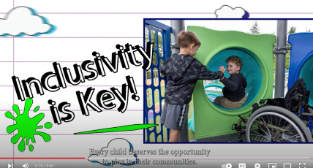
Cathy Bisaillon – President 2022-2024

Slide 3
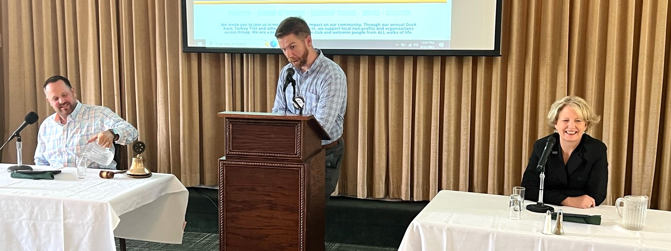
Inclusion – Many Firsts
Elections – Hosted County Commissioners’ Debate - 2022

Slide 4
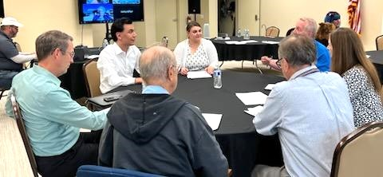
Inclusion
Hosted two Mock Interview Sessions – Persons with Disabilities

Slide 5
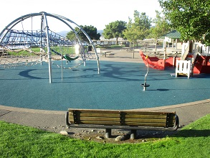
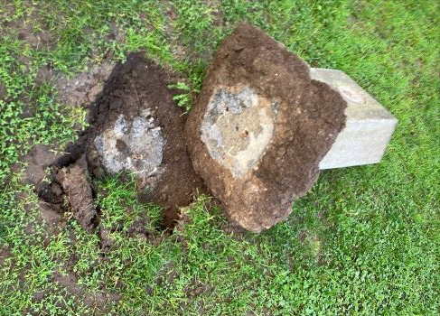
Inclusion – President’s Project
Silverdale Waterfront Park – removed worn illegible monuments
Exercised Kitsap Great Give opportunity for fund raising
Raised $12,600 for inclusive playground equipment
More to come in 2024-25!

Slide 6
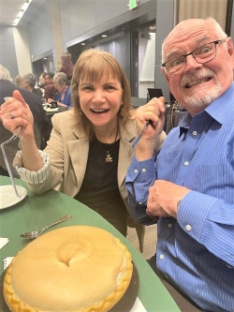
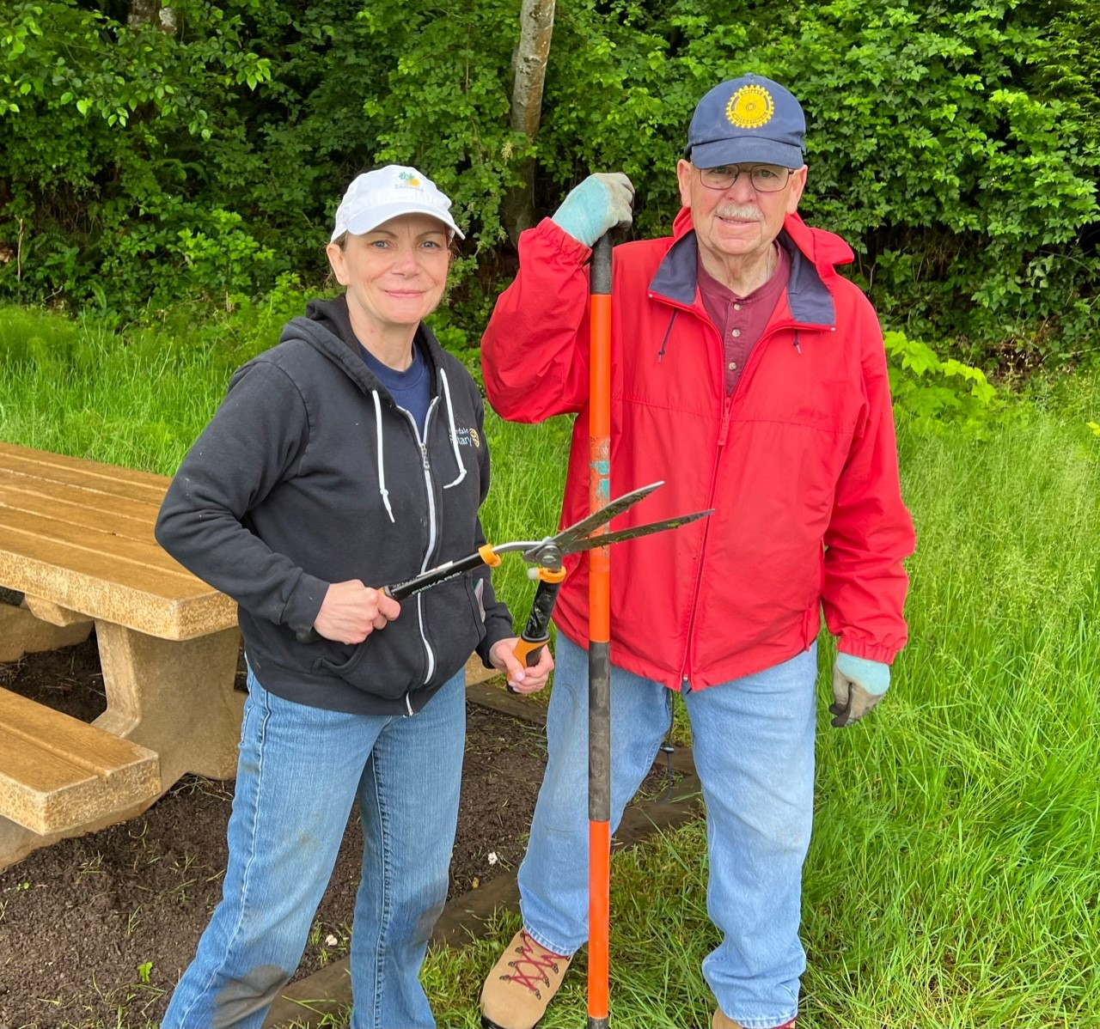
Supporting Area 9 Club Projects & Fundraisers
Bremerton Rotary Wild Game Dinner
Kitsap Crossroads Rotary
Port Gamble Forest Heritage Park

Slide 7


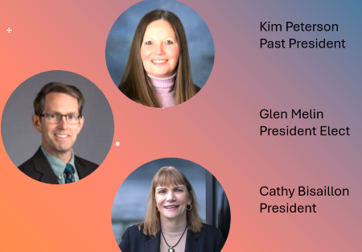
Organ Donor Awareness

Slide 8
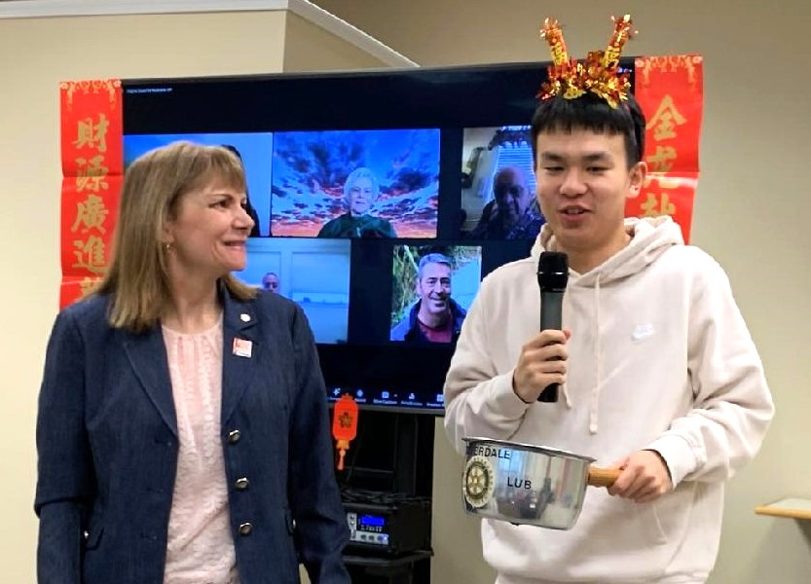
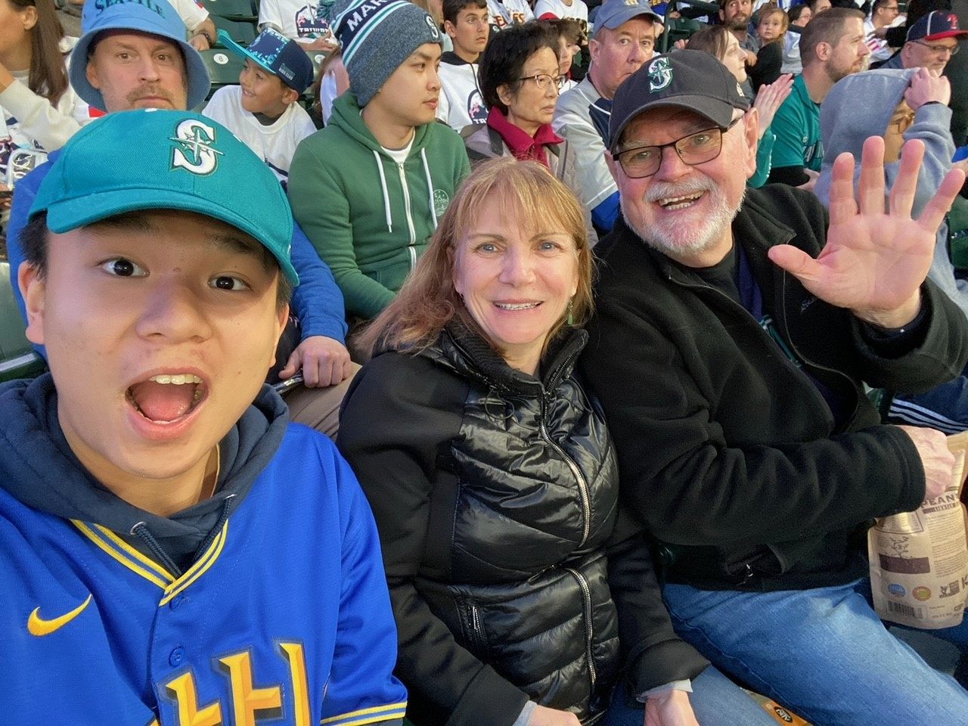
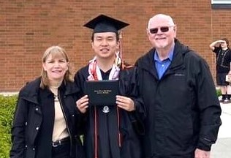
Host Parents – Ben Yang

Slide 9
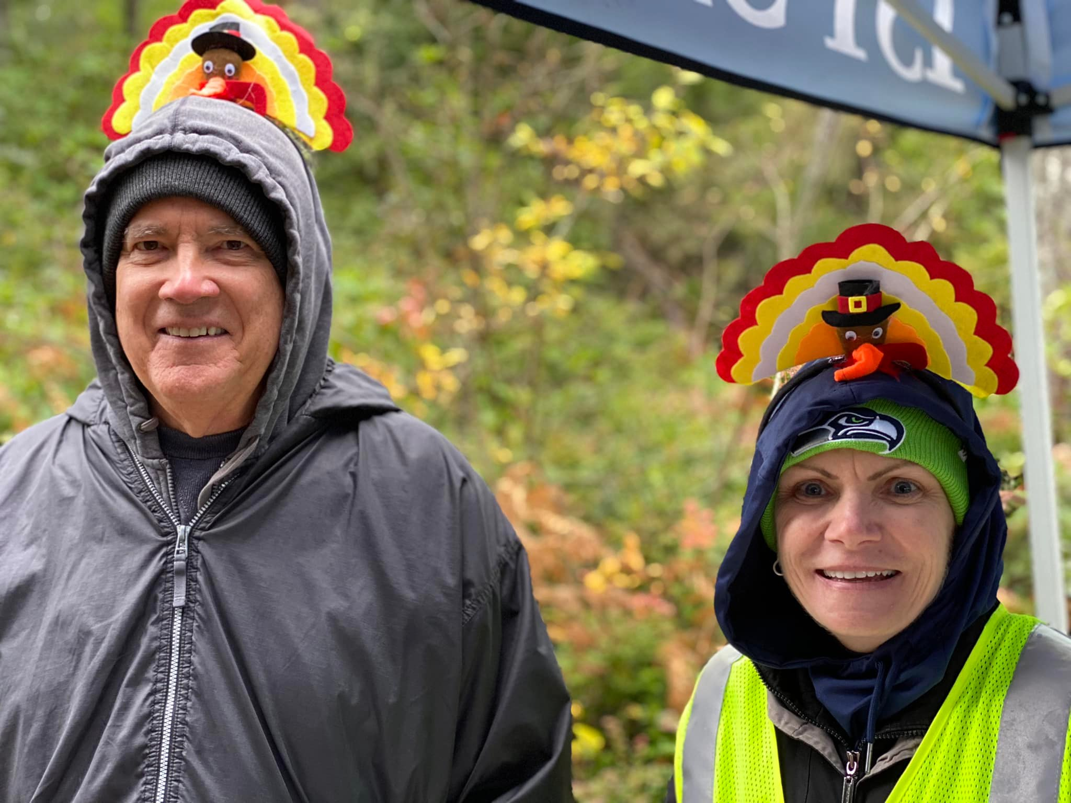
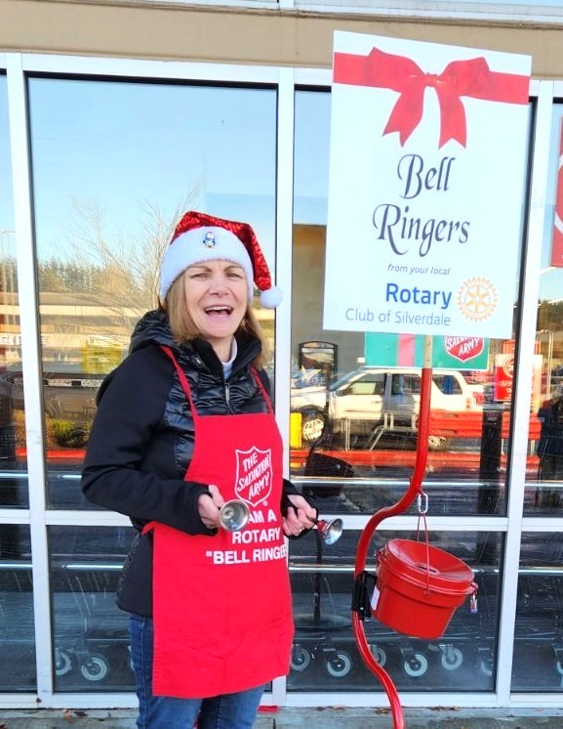
For the Community
Bell Ringing
Turkey Trot

Slide 10
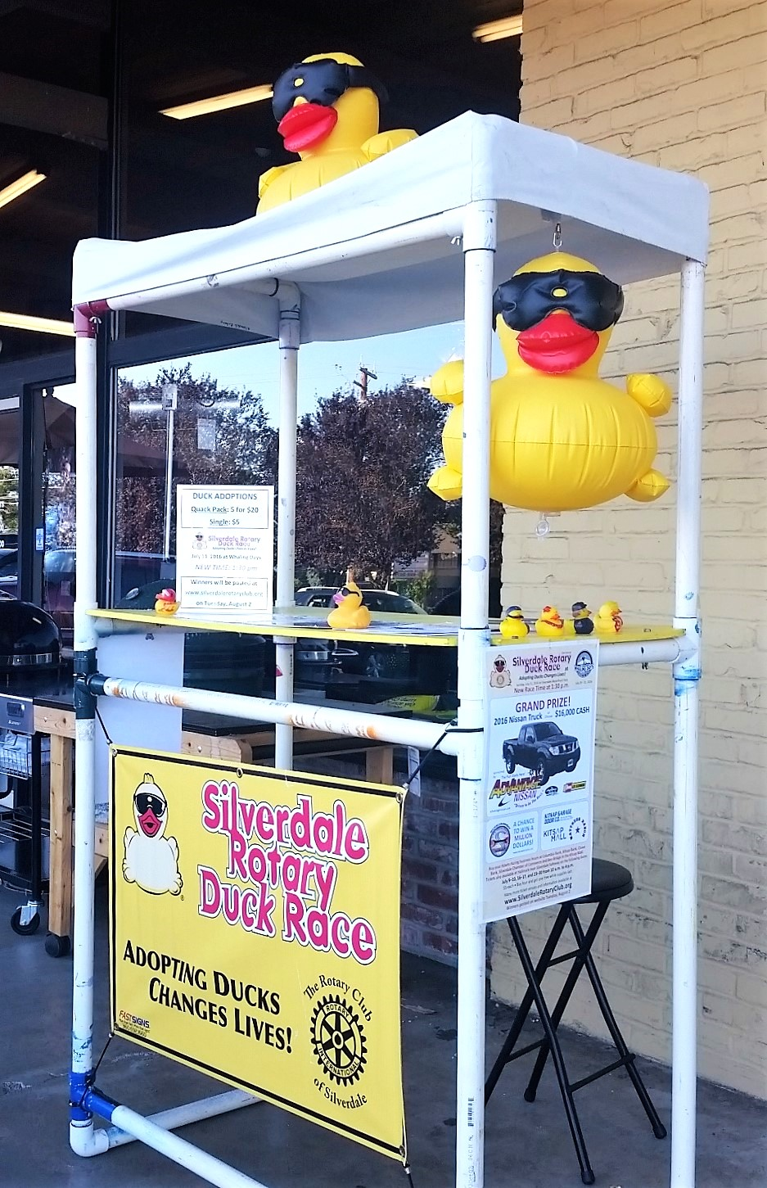
Duck Ticket
Seller
Extraordinaire!

Slide 11
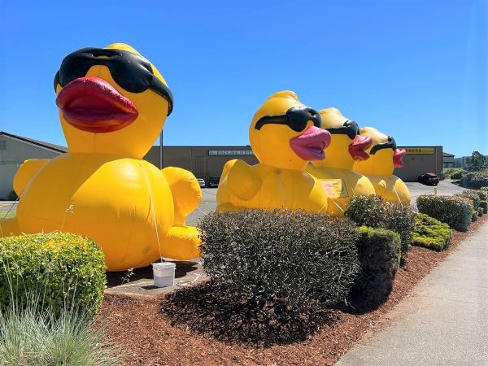
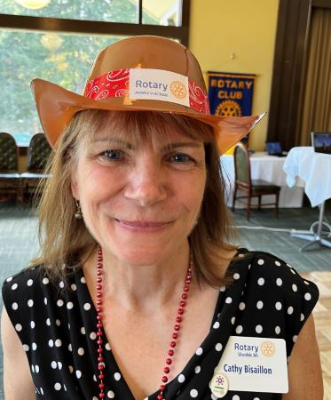
Trail Boss
Cathy’s Flock

Slide 12
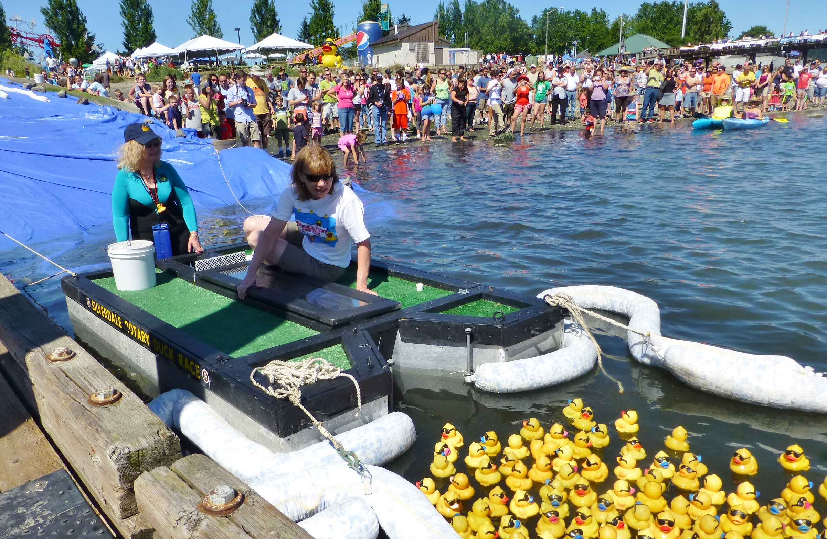
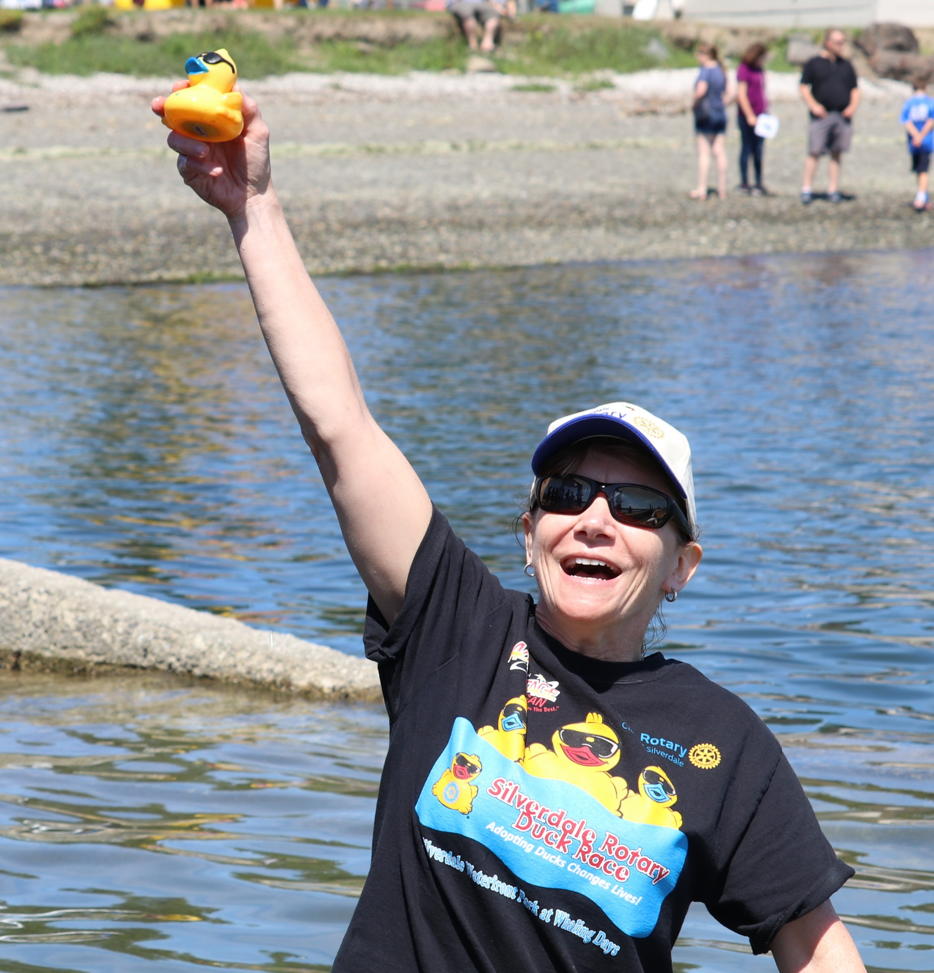
Duck Race Finish Line

Slide 13
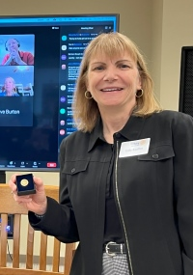

Rotary
Foundation Champion

Slide 14


LOTS of Wine Donations!

Slide 15
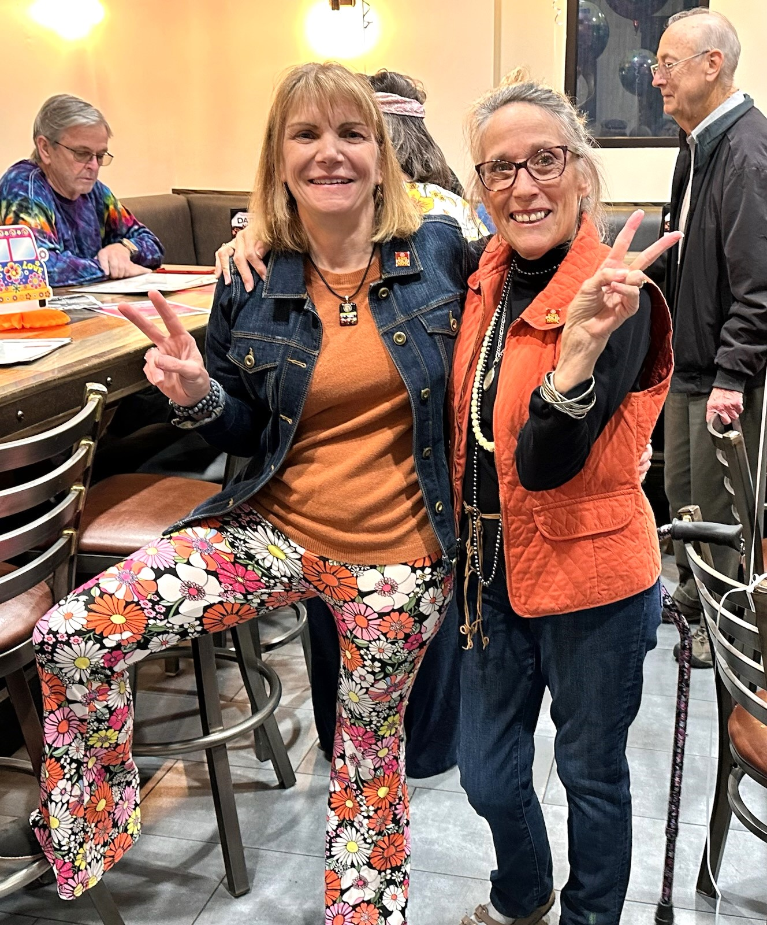
The
BIG
6-0!

Slide 16

THANK YOU, CATHY for
YOUR LEADERSHIP!

